Slide 1
Software Testing, Verification, Validation and Quality Assurance
Sujan Tamrakar
TESTING PRINCIPLES

Slide 2
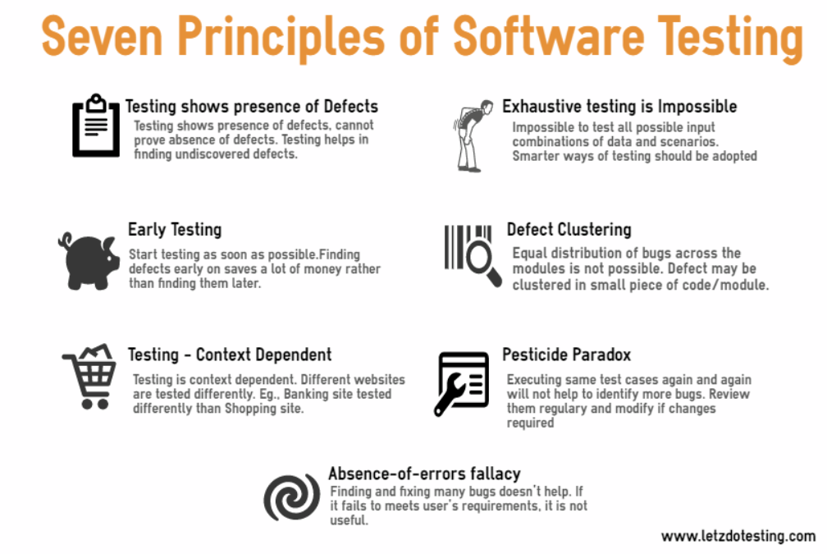

Slide 3
1. Testing shows the presence of bugs
Testing can show the defects are present but can’t prove that there are no defects.
Even after testing, we cannot say product is 100% error free.
Testing always reduces number of undiscovered defects BUT even if no defects are found, it is not a proof of correctness.
Thus, it is necessary to design test cases which can find as many defects as possible.

Slide 4
2. Exhaustive testing is impossible
Unless the AUT is small (simple logical structure & limited input), it isn’t possible to test all possible combinations of data & scenarios.
Testing everything including all possible combinations of input & pre-condition is not possible.
So, instead of doing the exhaustive testing we can use risks & priorities to focus testing efforts. Also budget, time and quality comes into consideration.
(large number of paths, huge data space)
Notes:
AUT = Application Under Test

Slide 5
3. Early testing
In SDLC, testing activities should start as early as possible & should be focused on defined objectives.
Sooner testing starts → Better utilization of available time → Quality product
Defects detected at early stages of SDLC are much cheaper and easier to fix.
Much effective & beneficial to change/fix bugs THAN having to change a functionality in large defective system.
Notes:
SDLC = software development life cycle

Slide 6
4. Defect Clustering
Small number of modules contain most of the defects in the system.
Most of the reported defects are related to small number of modules in the system.
This is the application of Pareto principle to software testing: Approximately 80% of the problems are found in 20% of the modules.
Notes:
SDLC = software development life cycle

Slide 7
5. Pesticide Paradox
If same kinds of tests are repeated again & again, eventually the same set of test cases will no longer be able to find any new bugs.
To overcome this pesticide paradox, it is really important to review the test cases regularly & new and different test cases need to be written to exercise different parts to find more defects.
Anytime a fault is fixed, we need to do regression testing to make sure new changes has not broken any other part of software.
Notes:
SDLC = software development life cycle

Slide 8
6. Testing is context dependent
Different kinds of software are tested differently.
All depends on type & nature of the application.
Medical (health related) software/device needs more testing than games.
Ex: Web apps are tested differently than mobile apps. Safety & critical software are tested differently than e-commerce applications.
Notes:
SDLC = software development life cycle

Slide 9
7. Absence of errors fallacy
Misconception / Myth
If testing doesn’t find any errors then it doesn’t mean the software is ready to be shipped.
Other factors (approaches) should be considered before shipping.
If system built is unusable and doesn’t fulfil the user’s need & expectations then, finding and fixing defects doesn’t help.
Notes:
SDLC = software development life cycle

Slide 10
Other principles:
Testing must be done by an independent party.
- Not the person or team that developed the software
Assign best personnel to the task (appropriate skilled).
- High creativity & responsibility is required
Keep software static during test.
- Program must not be modified during the implementation of set of designed test cases.
Test for invalid & unexpected input conditions as well as valid conditions.
Notes:
SDLC = software development life cycle

Slide 11
Thank you.

